Slide 1
Allocation of Funds Earmarked for Mortgage-Backed Securities
Matthew Seelig

Slide 2
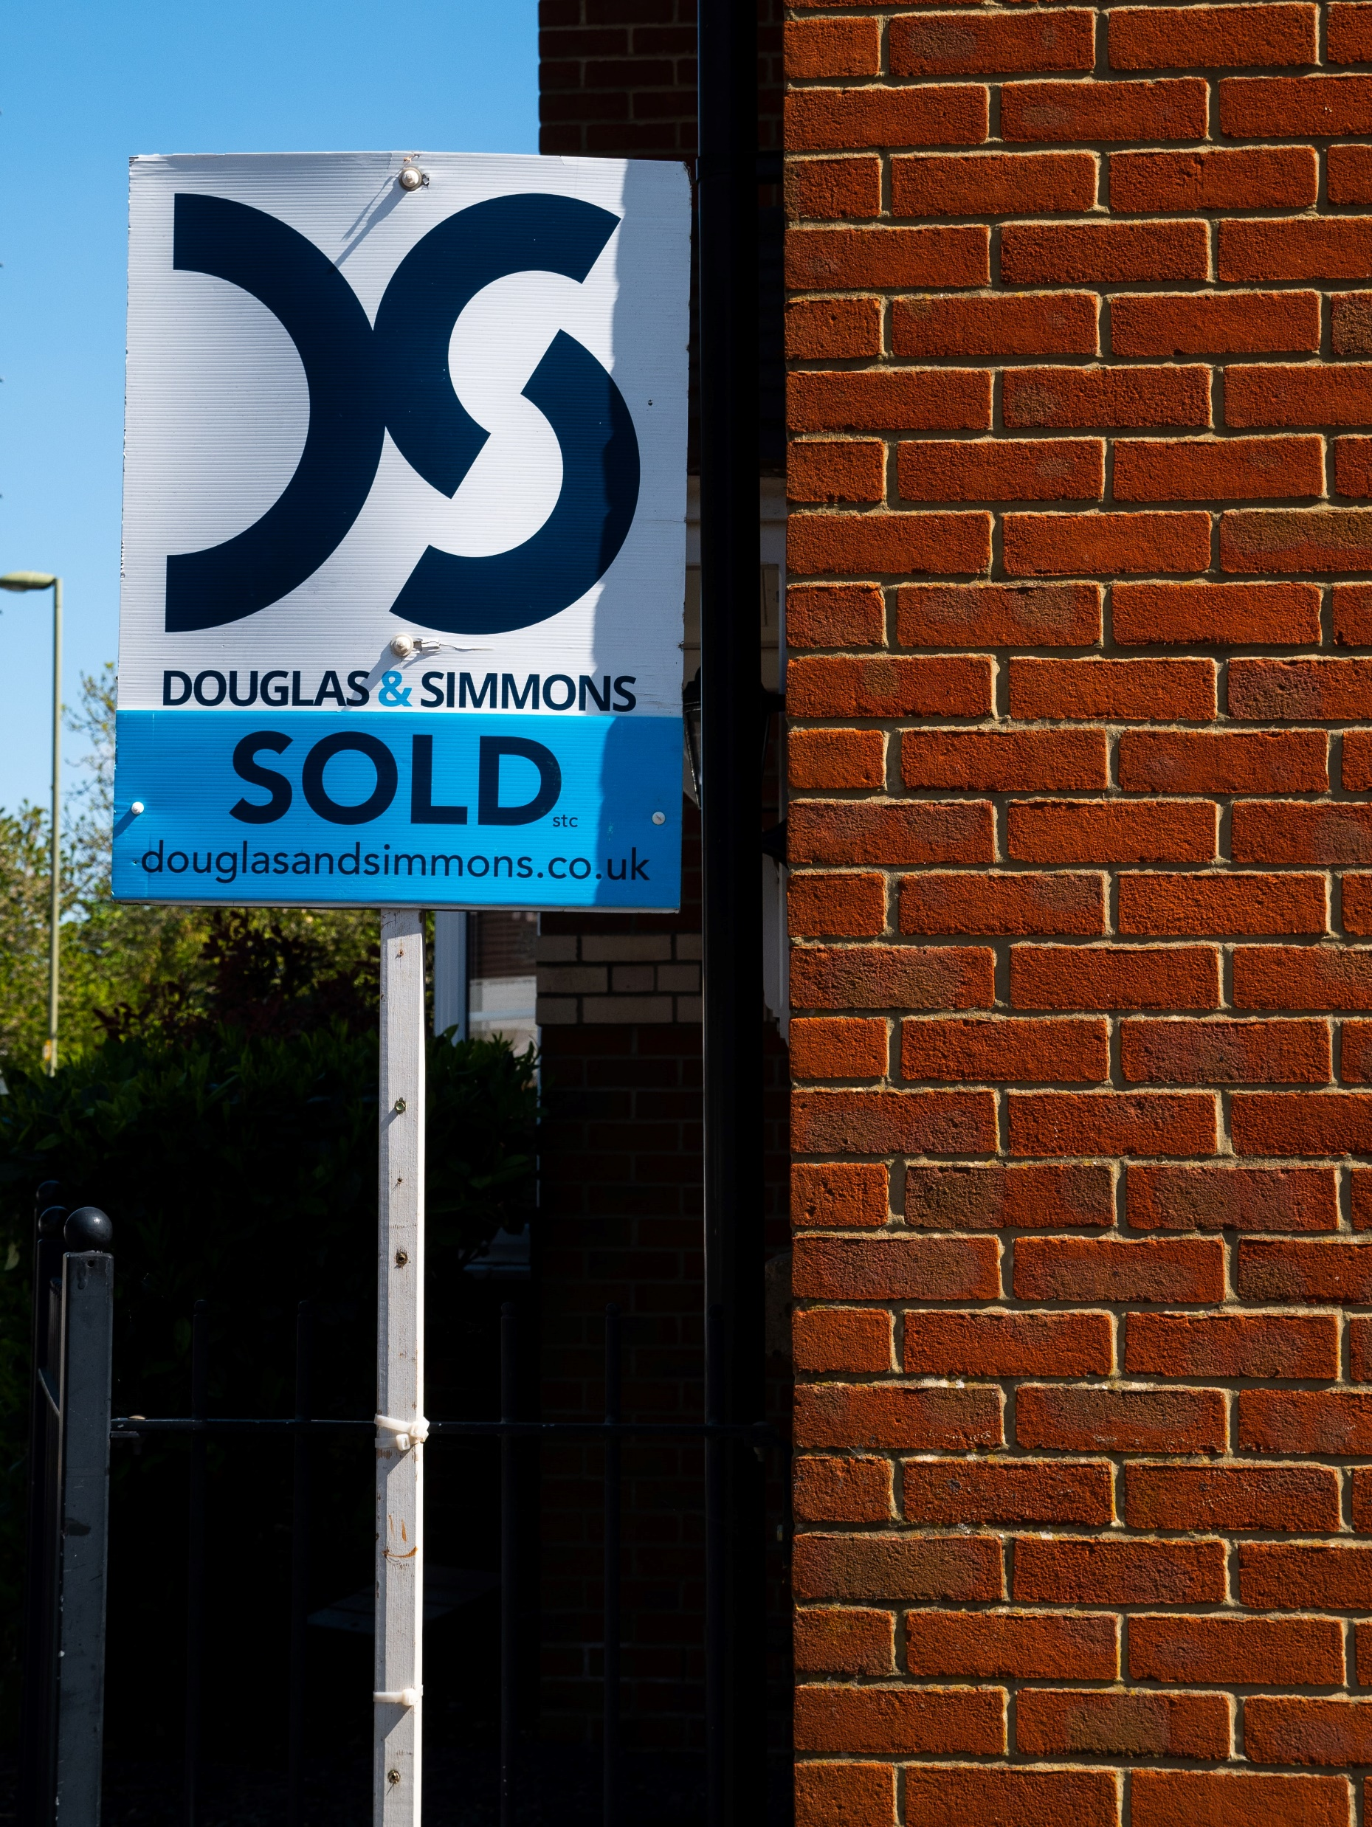
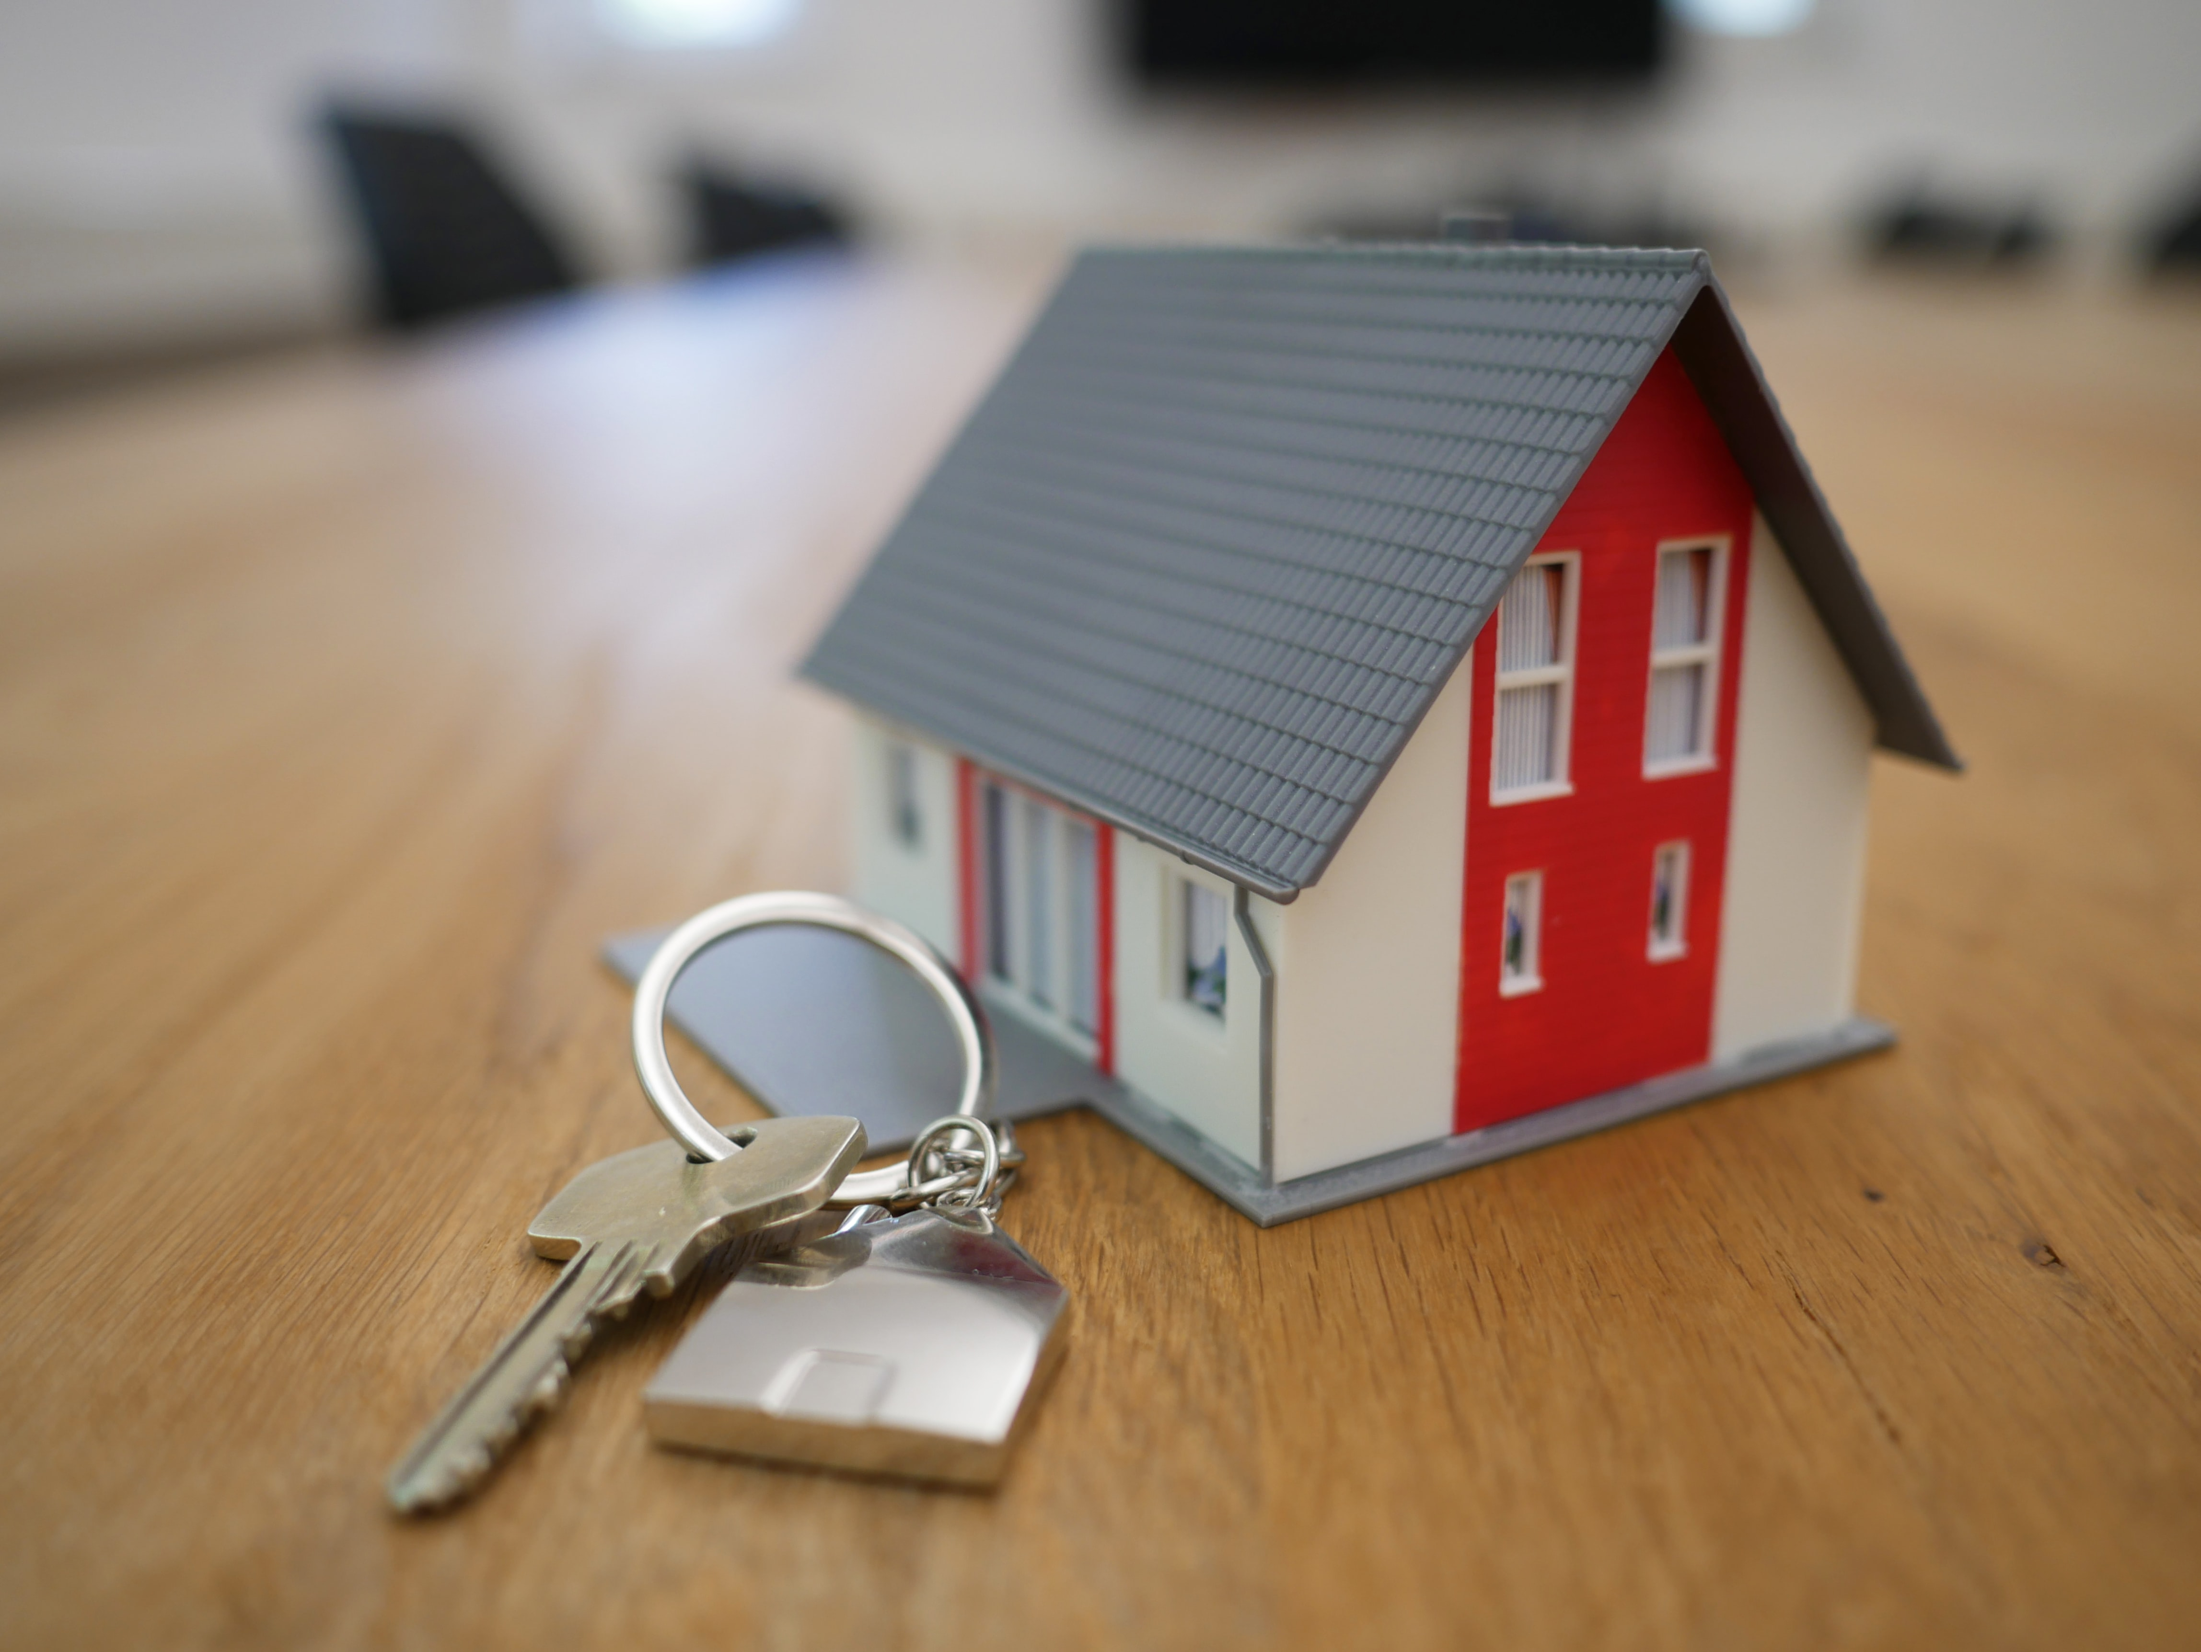
Purpose: Determine factors that drive the sale price of houses
Notes:
Good afternoon. The data analytics team was presented with the task of researching the factors that drive home prices, in order to maximize the potential revenue to be generated through the purchase of mortgage-backed securities. Currently, Lariat has a fleet of 4,000 vehicles that are responsible for approximately $60 million in revenue. After approximately $33 million in fixed costs related to the fleet, Lariat sees approximately $27 million in revenue.

Slide 3
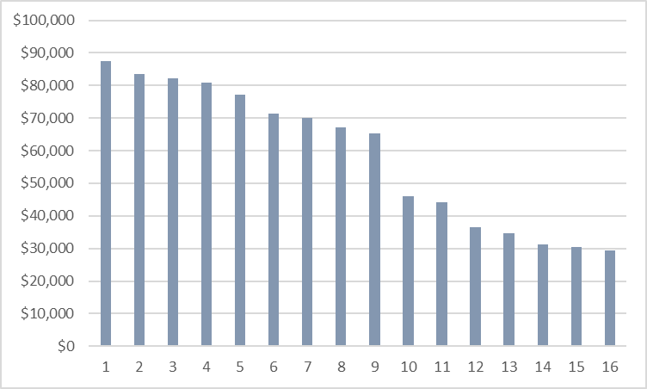
Review of the Data
1,460 houses sold in Ames, IA between 2006 and 2010
79 variables collected on the 1,460 house sales
19 hypotheses created based on the 79 variables
16 hypotheses were statistically significant and reflected a higher average sale price that was between $29,000 and $87,500
Notes:
In order to do so, the data analytics team reviewed a data set of 1,460 houses sold in Ames, Iowa between 2006 and 2010. The data set included 79 variables for each house, such as the year the house was constructed and whether it included a pool After reviewing the data set, the data analytics drafted nineteen hypotheses with the general structure of “houses with X have significantly different sales values than houses with Y,” such as “houses with a pool have significantly different sales values than house with no pool.” After performing statistical testing on these hypotheses, sixteen hypotheses were found to be statistically valid. The team then focused on the variables that represented the most significant difference between average sales prices, and the findings are as follows.

Slide 4
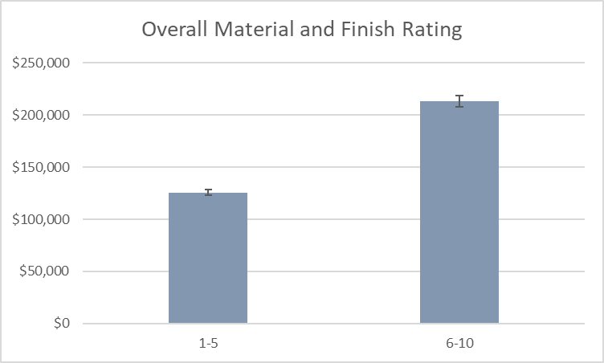
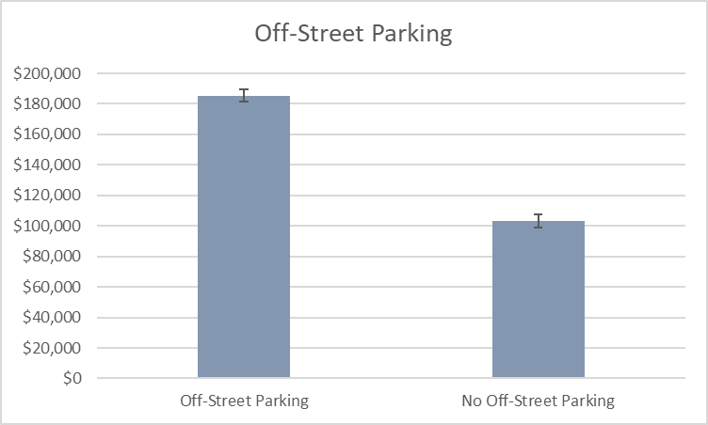
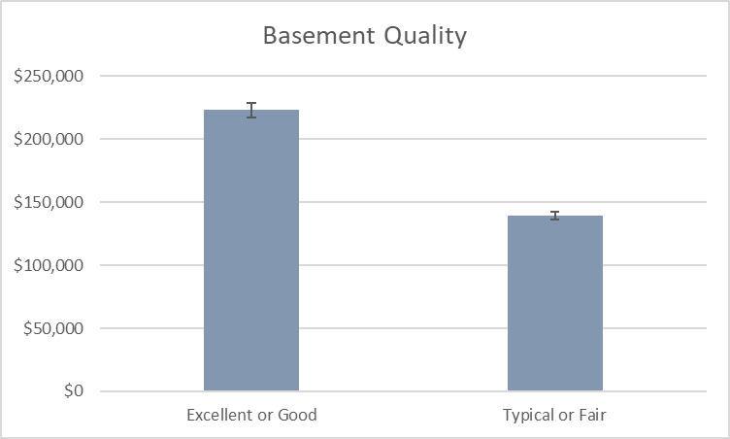
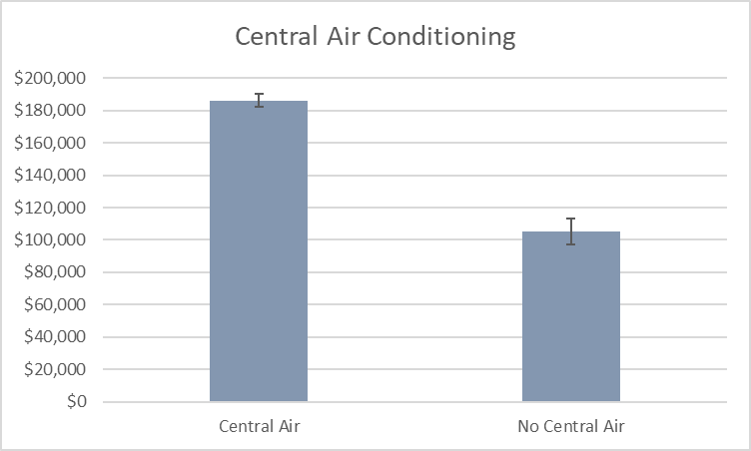
Findings
The variables that led to the four highest differences in sales prices are as follows:
Notes:
On a scale of one to ten, with ten being the highest quality, houses with an overall material and finish rating of between six and ten sold for an average of $87,000 more than houses with a rating of between one and five.
Houses with a basement quality of excellent or good sold for an average of $83,500 more than houses with a basement quality of typical or fair
Houses with off-street parking, such as a garage or carport, sold for an average of $82,000 more than houses without off-street parking
Houses with central air conditioning sold for an average of $81,000 more than houses without central air conditioning.

Slide 5
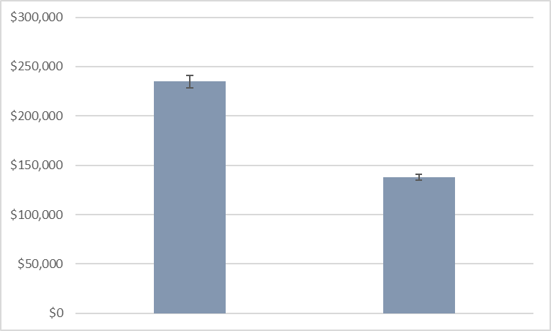
Prediction
Homes with the following attributes:
An overall material and finish rating of between 6 and 10
Off-street parking
A basement quality of Excellent or Good
Central air conditioning
will sell for between $90,000 and $104,000 more than homes that do not have all of these attributes
Notes:
Additional data analysis found that houses with all four of the attributes mentioned on the previous slide sold for an average of $96,000 more than houses that did not, and the data analytics team can predict that, in the future, houses that have all four of these attributes will sell for between $90,000 and $104,000 more than houses that do not.

Slide 6
Recommendation
Focus future purchases of mortgages on houses with the following attributes:
An overall material and finish rating of between 6 and 10
Off-street parking
A basement quality of Excellent or Good
Central air conditioning
Notes:
Based on this analysis, the team recommends that future purchases of mortgage-backed securities should focus on bundles consisting of houses that have these attributes and, wherever possible, bundles consisting of houses that have more than one of these attributes.

Slide 7
Questions?
Notes:
Based on this analysis, the team recommends that future purchases of mortgage-backed securities should focus on bundles consisting of houses that have these attributes and, wherever possible, bundles consisting of houses that have more than one of these attributes.

